Slide 1
Incident Response Station
IR 101 Track
Module 3: IR Plans and Playbooks

Slide 2

Outline
What is an incident response plan?
What is an incident response playbook / process?
How do these documents work together?

Slide 3
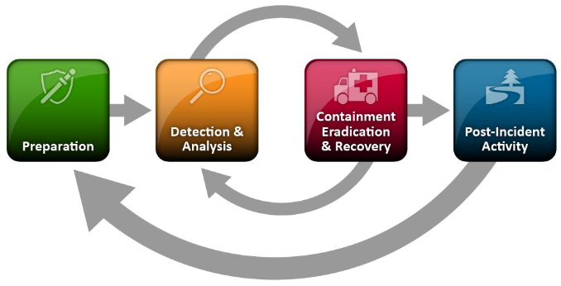
IRP - Lifecycle
The IRP will define the incident response lifecycle in your organization.
Depicted is the NIST incident response lifecycle.
Your IRP should define what happens in each of these phases and who is responsible.
Homework: Check out the NIST document SP800-61r2.

Slide 4
What is an Incident Response Playbook (IRPB)?
Also known as process, these are the guides for specific actions related to a type of threat.
Example: IRPB-Phishing. This playbook should have documented steps on how to respond to a phishing campaign / message in your environment.
Specific tools and how to use them can also be linked, creating a coordinated environment of documentation on how to achieve the goals.
Those linked documents may be known as runbooks or procedural documents.
Your IRP should link to your repository of IRPB documents.
This will be where the analysts go to find out how to do things.
These should be living documents that are specific to your organization.
Homework: Check out some IRPB templates from @ScoubiMtl: https://gitlab.com/syntax-ir/playbooks

Slide 5
How do these work together?
Tool Runbooks
The procedures
IR Play Books
The process
IR Plan The foundation
Notes:
The IR Plan acts as the foundation for your incident response program. This will document how the team gets engaged and what the communication paths are both internally and externally.
As we previously discussed, the IRP could/should point to a repository of IRPB documents that cover various incident types. One example might be a phishing campaign. Based on your IR plan this may not reach the level of criticality to enact the IR Plan, but your team can still find the appropriate IRPB to act on a phishing incident.
That IRPB for phishing will have the process level steps to take. Maybe log into your SIEM and check out the mail transaction logs.
This is where the runbooks come into play. These runbooks will document small specific procedures. For example: How to connect to your SIEM. How to search mail transaction logs.
The idea is to create small easy to follow and update procedures for tools and log sources that are commonly used and then refer to them in your playbooks. The playbooks will focus on the higer level process for the incident type and the IR Play will be the foundational document that explains how incidents are classified and who gets contacted at what level of criticality.

